Slide 1

WORDLE USING
DEEP REINFORCEMENT LEARNING
GROUP MEMBERS:
AM.EN.U4AIE20105 - ADITHYAN M NAIR
AM.EN.U4AIE20153 - NIVEDITA RAJESH

Slide 2
OBJECTIVE
To develop a deep reinforcement learning agent, utilizing the Deep Q-Network (DQN) algorithm with a Boltzmann exploration strategy, capable of efficiently deducing a hidden 5-letter word in the game Wordle in just 6 attempts.

Slide 3
INTRODUCTION
01
02
03
04
Applying RL principles to the Wordle game to minimize the number of attempts.
Wordle- a 5 letter word guessing game with 6 attempts.
Deep- Q network help guide the agent’s choice by balancing exploration and exploitation.
Boltzmann policy that uses a parameter function to guide the agents choice.

Slide 4

RL and WORDLE
A powerful tool for solving complex decision-making problems
Training intelligent agents by interacting with the environment.
RL provides a framework for optimizing the agent’s strategy
Develop an agent capable of efficiently deducting a 5-letter word in 6 tries
Game provides feedback after each play
Follows an exploration-exploitation tradeoff.

Slide 5
Deep Q-Network
Neural network that learns to approximate the Q-function.
Follows a exploration/exploitation tradeoff
Selects an action with the highest Q-value
Explores other actions with a small probability
Boltzmann Policy
Exploration strategy used to balance exploration and exploitation
select a guess based on its Q-value
lets the agent explore new guesses and avoid getting stuck
Overall, it improves the performance of RL agents in Wordle

Slide 6
Action Space
Discrete space with a size equal to the number of words in the word list
Each action corresponds to selecting one of the words
State Space
Represented by the 6x5 board array
Encodes the observation after each guess
1 indicates the letter is correct and in the right spot.
-1 indicates the letter is in the word but not in the right spot.
0 indicates the letter is not in the word.

Slide 7
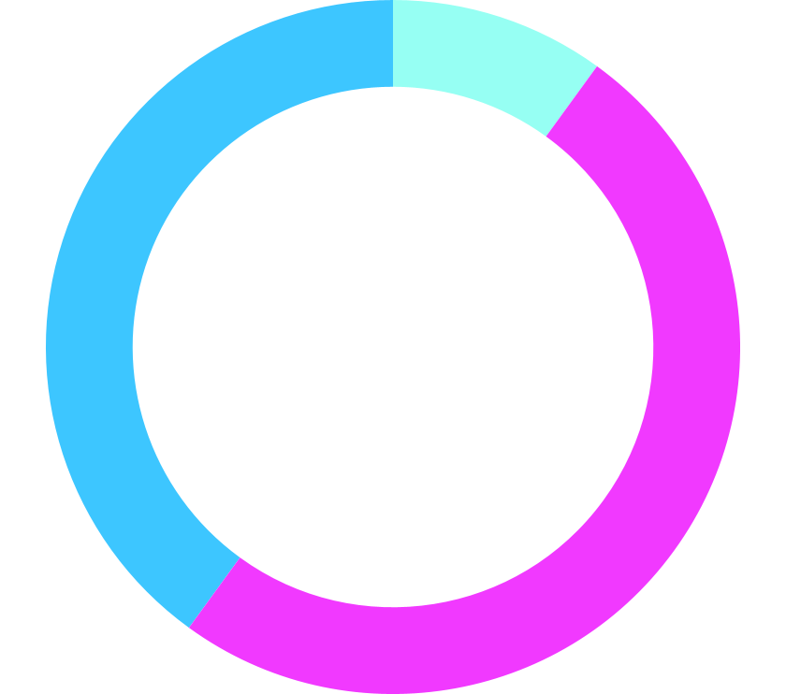
REWARD SYSTEM
A reward of 100 is given for guessing the word correctly.
Else, the reward is based on the score from comparing the guess to the target word
+10 for each correctly placed letter
+5 for each letter in the word but wrong spot
-10 for each letter not in the word

Slide 8
METHODOLOGY
Wordle Game Functions:
wordle_obs_from_words: Updates board based on guess
wordle_score_guess: Calculates reward for guess
WordleEnv: Gym RL environment
Action: Guess word
Observation: Board state
Methods: reset, step, render
DQN Model: Approximates Q-values
Fully-connected neural network
Memory: Experience replay
Improves training stability
Agent & Policy:
DQN agent with exploration policy

Slide 9
PLOT REWARDS
TRAINING
TESTING
RESULTS
02
04
Visualize learning
&
Iterate till optimal policy
Interact & learn via RL
01
03
Evaluate agent performance
Agent able to master Wordle via RL

Slide 10
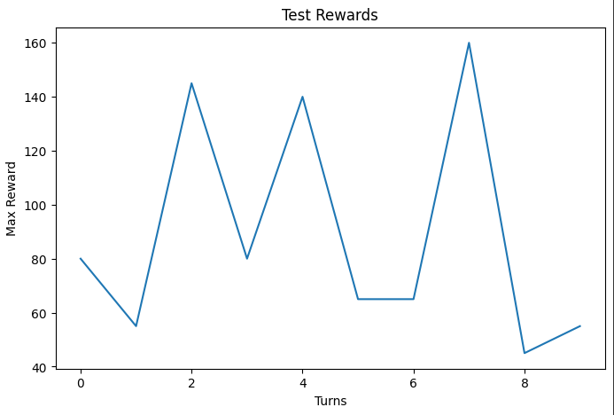
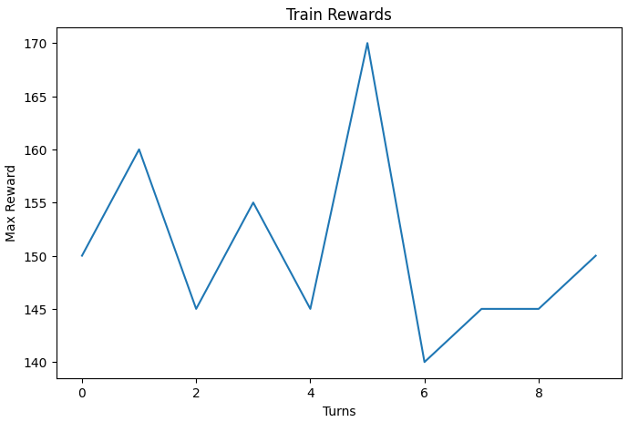
RESULT
Rewards trended upwards - indicates agent learned better policies over time
Fluctuations in rewards - variability expected due to training stochasticity
Inconsistencies show Wordle task challenge and limitations of approach
Potential improvements - more training episodes, regularization, hyperparameter tuning
Significance - shows promise of deep RL for similar task domains
Limitations - variability highlights room for improvement in training
Future work - reduce fluctuations, improve generalization, optimize efficiency

Slide 11
CHALLENGES & LIMITATIONS
Fixed Word list
Sparse Rewards
Computational inefficiency
Local Optima
Overfitting
Sample Inefficiency

Slide 12
CONCLUSION
Showcases the effectiveness of Deep Q-Network (DQN) and Boltzmann exploration in tackling the Wordle
Reinforcement learning proves invaluable in optimizing decision-making strategies in interactive games
Highlights the adaptability of reinforcement learning in mastering complex puzzles

Slide 13
THANK YOU

